Slide 1

Image Fusion of Infrared(IR) and Visible images using a novel Hybrid MSD approach
Presented
By
NITIN P KHATAWATE [1DS13CS067]
SHIVPRASAD ACHARI [1DS13CS091]
SOUMIL BISWAS [1DS13CS099]
TANISH V SUGNANI [1DS13CS110]
Under the Guidance of
Dr. Shubha Bhat Mr.Sasidhara Bola
Assoc. Professor Asst. Professor
Dept .of CSE Dept .of CSE
Bangalore Bangalore
Department of Computer Science & Engineering, DSCE

Slide 2
OVERVIEW
The presentation would deal with the following:
Introduction
Objective
Literature survey
Methodology
Architecture Diagram
Flowchart
Experiments
Results
Conclusion
References
Department of Computer Science & Engineering, DSCE

Slide 3
INTRODUCTION
In computer vision, Multi sensor Image fusion is the process of combining relevant information from two or more images into a single image. The resulting image will be more informative than any of the input images.
Since IR sensors are able to capture thermal information in a scene that is not directly seen by human eyes, they can more clearly detect some objects in lowlight, occlusion and adverse weather conditions.
Visible imagery normally provides more details of the scene in the visible spectrum, and also presents more natural intensities and contrasts that are consistent with human visual perception.
In this project, we present a multi scale fusion method to achieve better fusion results for human visual perception.
Department of Computer Science & Engineering, DSCE

Slide 4
l
OBJECTIVE
The main objective is to fuse images mainly the visible and infrared images to enhance the information of output image which could be helpful for many applications, especially for surveillance of sensitive border regions to locate enemies particularly in the forest/mountain areas Our objective is to increase the image quality by detecting and reducing the several kinds of distortion namely :
Impulse Noise (Salt and Pepper Noise)
Gaussian Noise (Amplifier Noise)
Poisson Noise
Speckle Noise
Department of Computer Science & Engineering, DSCE

Slide 5
l
LITERATURE SURVEY
Automatic motion tracking of a human in a surveillance video, Mohammed A. AlGhamdi, Murtaza A. Khan, Sultan H. AlMotiri
In this paper we describe a method of automatic motion tracking of a person in a sequence of video frames. The method is suitable for tracking a person walking or running in a surveillance video captured from a single still camera. The method initially removes noise from the captured images then segments the images using frame difference and binary conversion techniques and finally tracks the person using a bounding box based on occurrence of high intensity values horizontally and vertically. Simulation results show that the method can be used for real-time tracking of humans in videos with frame-rate of 25/30 fps. In the context of a Smart-city, the purposed system serves as a part of Internet of Things (IoT) and transmits the capture video to control-center for processing.
Department of Computer Science & Engineering, DSCE

Slide 6
l
LITERATURE SURVEY
J. Liu, Y. Gu, and S. Kamijo, “Customer Behavior Recognition in Retail Store from Surveillance Camera,” in IEEE International Symposium on Multimedia (ISM), 2015
The analysis of customer behavior from surveillance camera is one of the most important open topics for marketing. The authors develop a system to recognize different customer behaviors on the front of shelf: no interest, viewing, turning to shelf, touching, picking and returning to shelf and picking and putting into basket. In the proposed system, head orientation, body orientation, and arm action, the multiple cues are integrated for the customer behavior recognition. The proposed system discretizes the head and body orientation of customer into 8 directions to estimate whether the customer is looking or turning to the merchandise shelf. Semi-Supervised Learning method is applied to optimize the training dataset and to generate an accurate classifier. As for the arm action recognition, a novel combined hand feature (CHF), which includes hand trajectory, tracking status and the relative position between hand and shopping basket, is proposed to describe different arm actions.
Department of Computer Science & Engineering, DSCE

Slide 7
l
LITERATURE SURVEY
J. Liu, Y. Gu, and S. Kamijo, “Joint Customer Pose and Orientation Estimation using Deep Neural Network from Surveillance Camera,” in IEEE International Symposium on Multimedia (ISM), 2016
Retailers are most concerned with the customers near the merchandise shelf. In those areas, the customer pose and orientation are highly dependent on each other. Therefore, the authors propose a joint customer pose and orientation estimation system from surveillance video by using deep Neural Network. This system composes the dependency between pose and orientation. In addition, considering the customer pose and orientation changes gradually over time, the authors apply a prediction structure to improve the system performance. In this structure, the estimated pose and orientation of one frame are both used to enhance the estimation of next frame. We also propose a two-step learning algorithm to train this network. The experimental results also prove the effectiveness of our proposed system.
Department of Computer Science & Engineering, DSCE

Slide 8
l
LITERATURE SURVEY
Motion Detection Techniques Using Optical Flow, A. A. Shafie, Fadhlan Hafiz, and M. H. Ali
Motion detection is very important in image processing. One way of detecting motion is using optical flow. Optical flow cannot be computed locally, since only one independent measurement is available from the image sequence at a point, while the flow velocity has two components. A second constraint is needed. The method used for finding the optical flow in this project is assuming that the apparent velocity of the brightness pattern varies smoothly almost everywhere in the image. This technique is later used in developing software for motion detection which has the to carry out four types of motion detection. The motion detection software presented in this project also can highlight motion region, count motion level as well as counting object numbers. Many objects such as vehicles and human from video streams can be recognized by applying optical flow technique.
Department of Computer Science & Engineering, DSCE

Slide 9
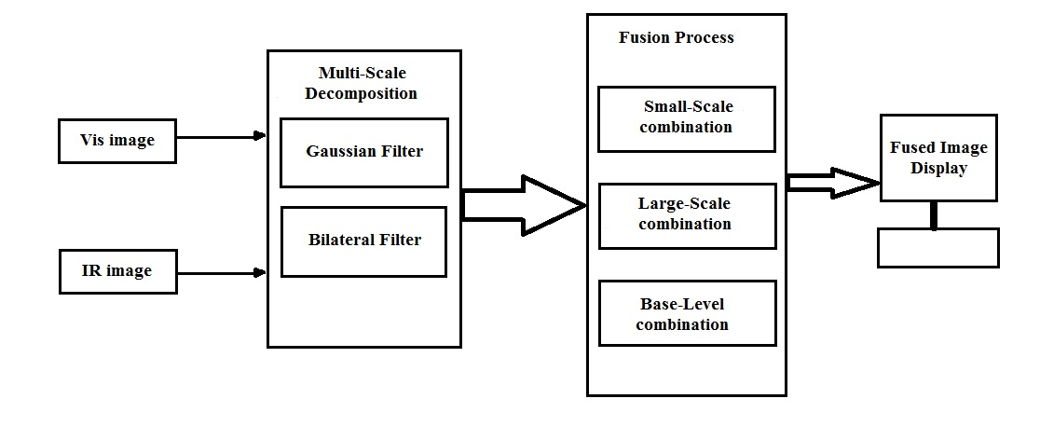
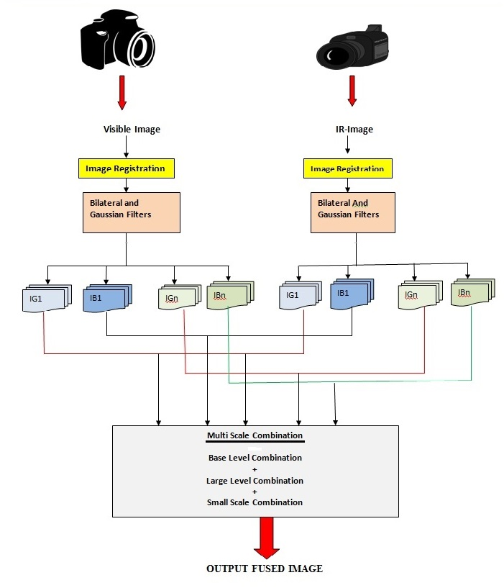
ARCHITECTURE DIAGRAM
Department of Computer Science & Engineering, DSCE

Slide 10
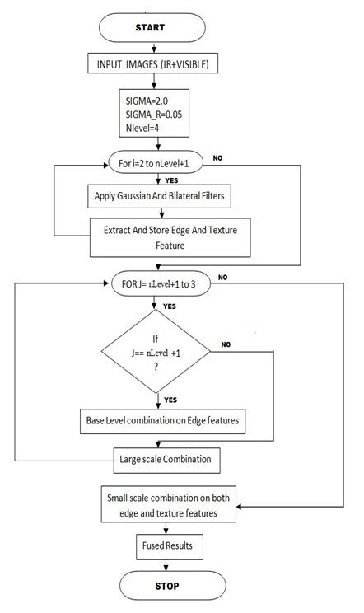
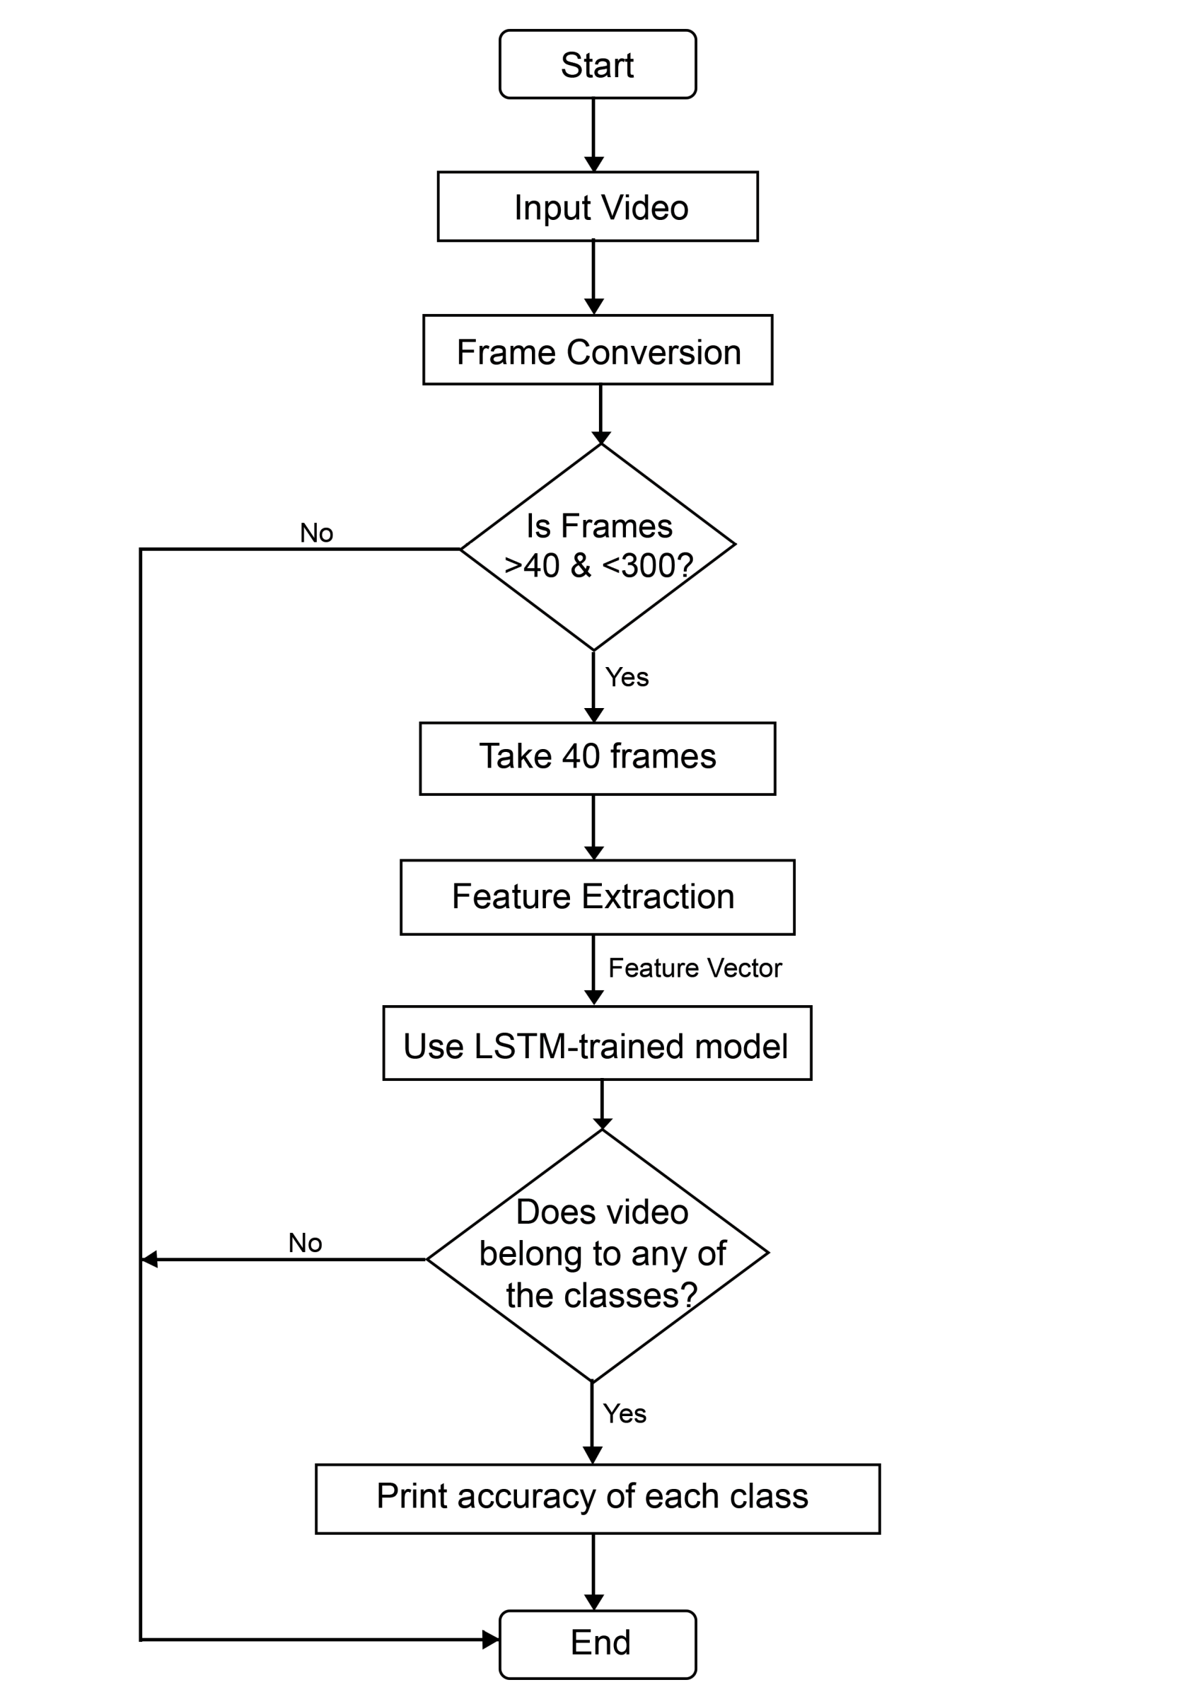
FLOWCHART
Department of Computer Science & Engineering, DSCE

Slide 11
METHODOLOGY
The proposed approach comprises of two steps:
1. MSD based on Gaussian and Bilateral filters
2. Infrared and visible image fusion based on
2.1. Small and large-scale combinations.
2.2. Base level combination.
Department of Computer Science & Engineering, DSCE

Slide 12
METHOLOGY(CONTINUED)
Step 1 Small-Scale combination:
Small scale combination is used to integrate fine-scale features into fused image it is applied to the original image. The value of lambda is used to regulate the amount of IR image features to be injected in the visible image for better visual perception.
Step 2 Large-Scale combination:
The large-scale levels are chosen to include all the decomposed levels. At these scale levels, the decomposed large-scale edge features are fully used to identify and determine the weights of corresponding IR spectral features that would be injected into the visible image.
Step 3 Base-Level combination:
The use of base image in image fusion is that it generally provides the support information for the higher-frequency sub-bands. They are closely associated with each other in scale-spaces. So it is reasonable that the construction of the fused base image would also be related to the higher-level decomposed information in the fusion process.
Department of Computer Science & Engineering, DSCE

Slide 13
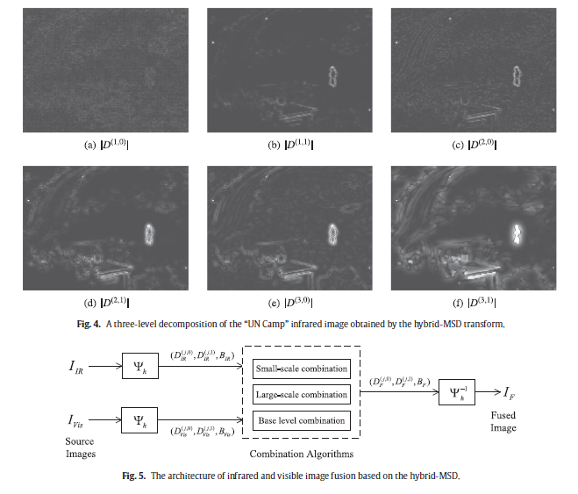
Department of Computer Science & Engineering, DSCE

Slide 14
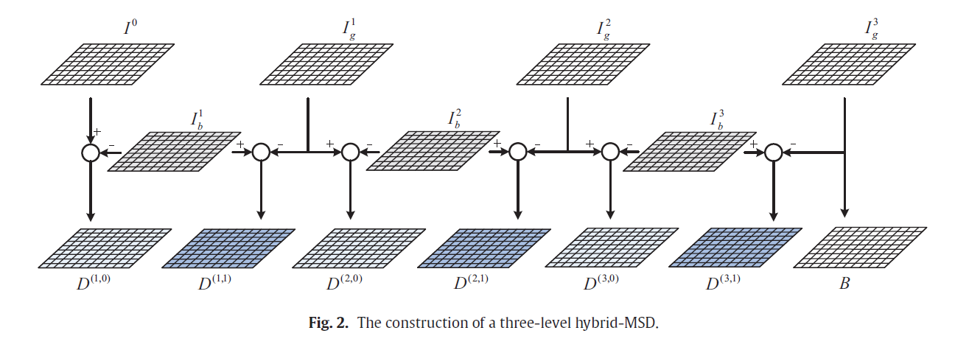

Slide 15
EXPERIMENTS
We selected few of the standard visible and IR images which are, "meting012", "Road", "T1“, ”Dune”, ”Camp” ,”Road” , etc are been selected from "https://figshare.com/articles/TNO_Image_Fusion_Dataset " to assess the performance of the proposed method.
We considered other two existing methods Stationary Wavelet Tranform (SWT) and Pulse-Coupled Neural Network (PCNN) to compare the performance corresponding to the proposed hybrid MSD method.
The corresponding comparison for different images set and various performance parameter are show in the graphs.
From the Graph and table we can see that the proposed methods in more efficient.
Department of Computer Science & Engineering, DSCE

Slide 16
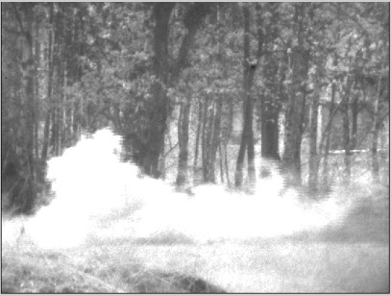
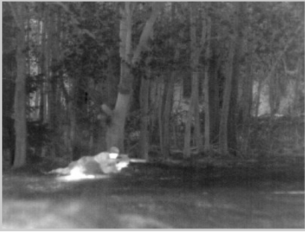
INPUT IMAGES
Visible Image
IR Image

Slide 17
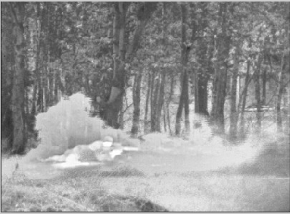
cv
OUTPUT
Department of Computer Science & Engineering, DSCE

Slide 18
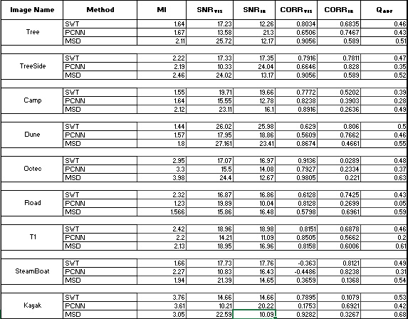
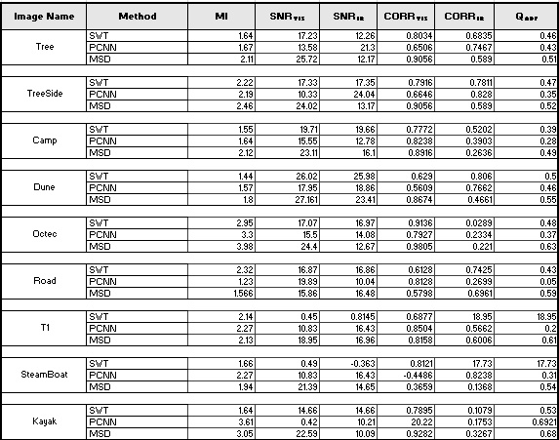

Slide 19
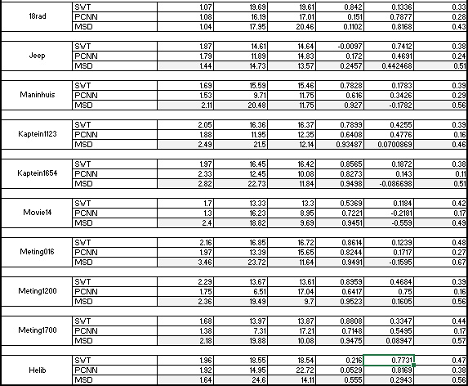

Slide 20
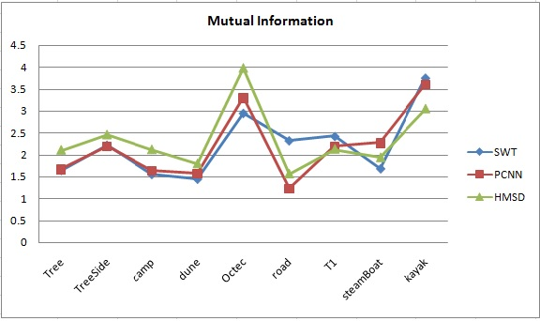
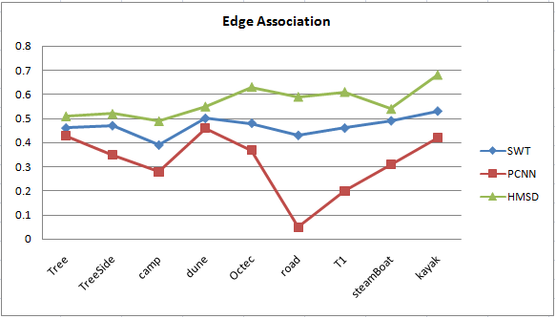
RESULTS
Department of Computer Science & Engineering, DSCE

Slide 21
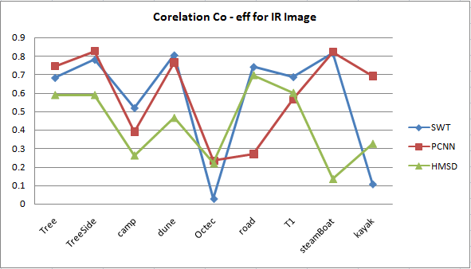
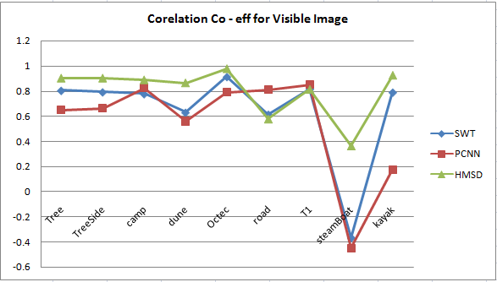
cv
RESULTS
Department of Computer Science & Engineering, DSCE

Slide 22
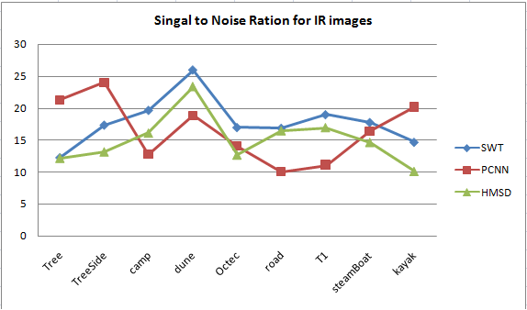
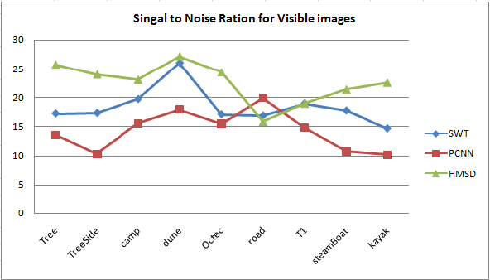
cv
RESULTS
Department of Computer Science & Engineering, DSCE

Slide 23
CONCLUSION
In this project, a novel method to fuse Infrared (IR) and visible images has been proposed based on combining rule for a multi scale decomposition based image fusion. We use statistical filter data of a visible image for transformation to refine major information of IR image.
The filters can be used to identify and select important IR spectral features from the infrared image to inject them into the visible image. By further employing different combination algorithms adaptively according to different information scale levels in the fusion process, we can preserve or properly enhance the background scenery and details from the visible image which provide important perceptual cues for human observation.
Experimental results demonstrate that the proposed fusion method is able to provide perceptually better fusion results compared with various other pixel-based multi-scale fusion algorithms.
Department of Computer Science & Engineering, DSCE

Slide 24
REFERENCES
[1] Wei Gan, Xiaohong Wu, Wei Wu, Xiaomin Yang, Chao Ren, Xiaohai He, Kai Liu, "Infrared and visible image fusion with the use of multi-scale edge-preserving decomposition and guided image filter”, ELSEVIER Infrared Physics & Technology, Volume 72, September 2015, Pages 37–51
[2] Y. Chai, H.F. Li, J.F. Qu, "Image fusion scheme using a novel dual-channel PCNN in lifting stationary wavelet domain", ELSEVIER Optics Communications, Volume 283, Issue 19, 1 October 2010, Pages 3591–3602
[3] Weiwei Kong, Longjun Zhang, Yang Lei, "Novel fusion method for visible light and infrared images based on NSST–SF–PCNN", ELSEVIER Infrared Physics & Technology, Volume 65, July 2014, Pages 103–112
[4] Pusit Borwonwatanadelok, Wirat Rattanapitak and Somkait Udomhunsakul, "Multi-Focus Image Fusion based on Stationary Wavelet Transform and extended Spatial Frequency Measurement”, International Conference on Electronic Computer Technology 2009
Department of Computer Science & Engineering, DSCE

Slide 25
REFERENCES (CONTINUED)
[5] Shutao Li, "Multisensor Remote Sensing Image Fusion using Stationary Wavelet Transform: effects of basis and Decomposition Level", International Journal of Wavelets, Multiresolution and Information Processing Volume 06, Issue 01, January 2008
[6] Sukhjinder Kaur, "Noise Types and Various Removal Techniques", International Journal of Advanced Research in Electronics and Communication Engineering (IJARECE) Volume 4, Issue 2, February 2015
[7] Mr. Rohit Verma and Dr. Jahid Ali, "A Comparative Study of Various
Types of Image Noise and Efficient Noise Removal Techniques", International Journal of Advanced Research in Computer Science and Software Engineering Volume 3, Issue 10, October 2013
[8] Yi Wang, Zhonghua Luo, Zhihai Xu, Huajun Feng, Qi Li, Yueting Chen, “Fusion of Infrared and Visual Images Through Multi-scale Hybrid Unidirectional Total Variation”, IEEE International Conference on Signal and Image Processing (ICSIP) 2016.
Department of Computer Science & Engineering, DSCE

Slide 26
QUESTIONNAIRE
Department of Computer Science & Engineering, DSCE

Slide 27
THANK YOU
Department of Computer Science & Engineering, DSCE

